Slide 1
DISJOINT SET FOREST
By
Mr. GURURAJ
Assistant Professor-Selection Grade
Department of Computer Science & Engineering
M.I.T Manipal

Slide 2
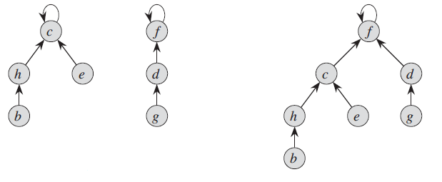
DISJOINT SET FOREST
A faster implementation of disjoint sets is through the rooted trees, with each node containing one member and each tree representing one set.
Each member in the tree has only one parent.

Slide 3
Heuristics to improve the running time
Union by rank, is similar to the weighted-union heuristic we used with the linked-list representation.
For each node, we maintain a rank, which is an upper bound on the height of the node.
Make the root of the tree with fewer nodes point to the root of the tree with more nodes.
In union by rank, we make the root with smaller rank point to the root with larger rank during a UNION operation.

Slide 4
Heuristics to improve the running time
Path compression
-simple and highly effective.
- Used during FIND-SET operations to make each node on the find
path point directly to the root.
-Path compression does not change any ranks.

Slide 5
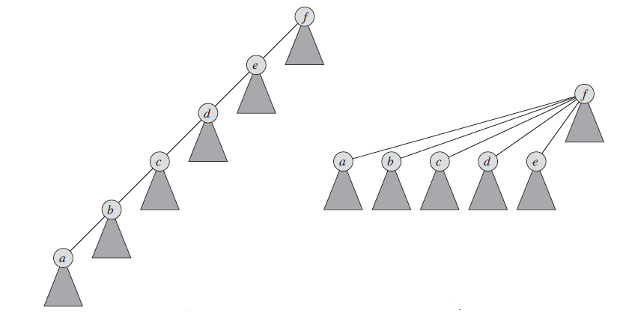
Heuristics to improve the running time
The same set after executing FIND-SET
A tree representing a set prior to executing FIND-SET.
Path compression during the operation FIND-SET.

Slide 6
